Slide 1
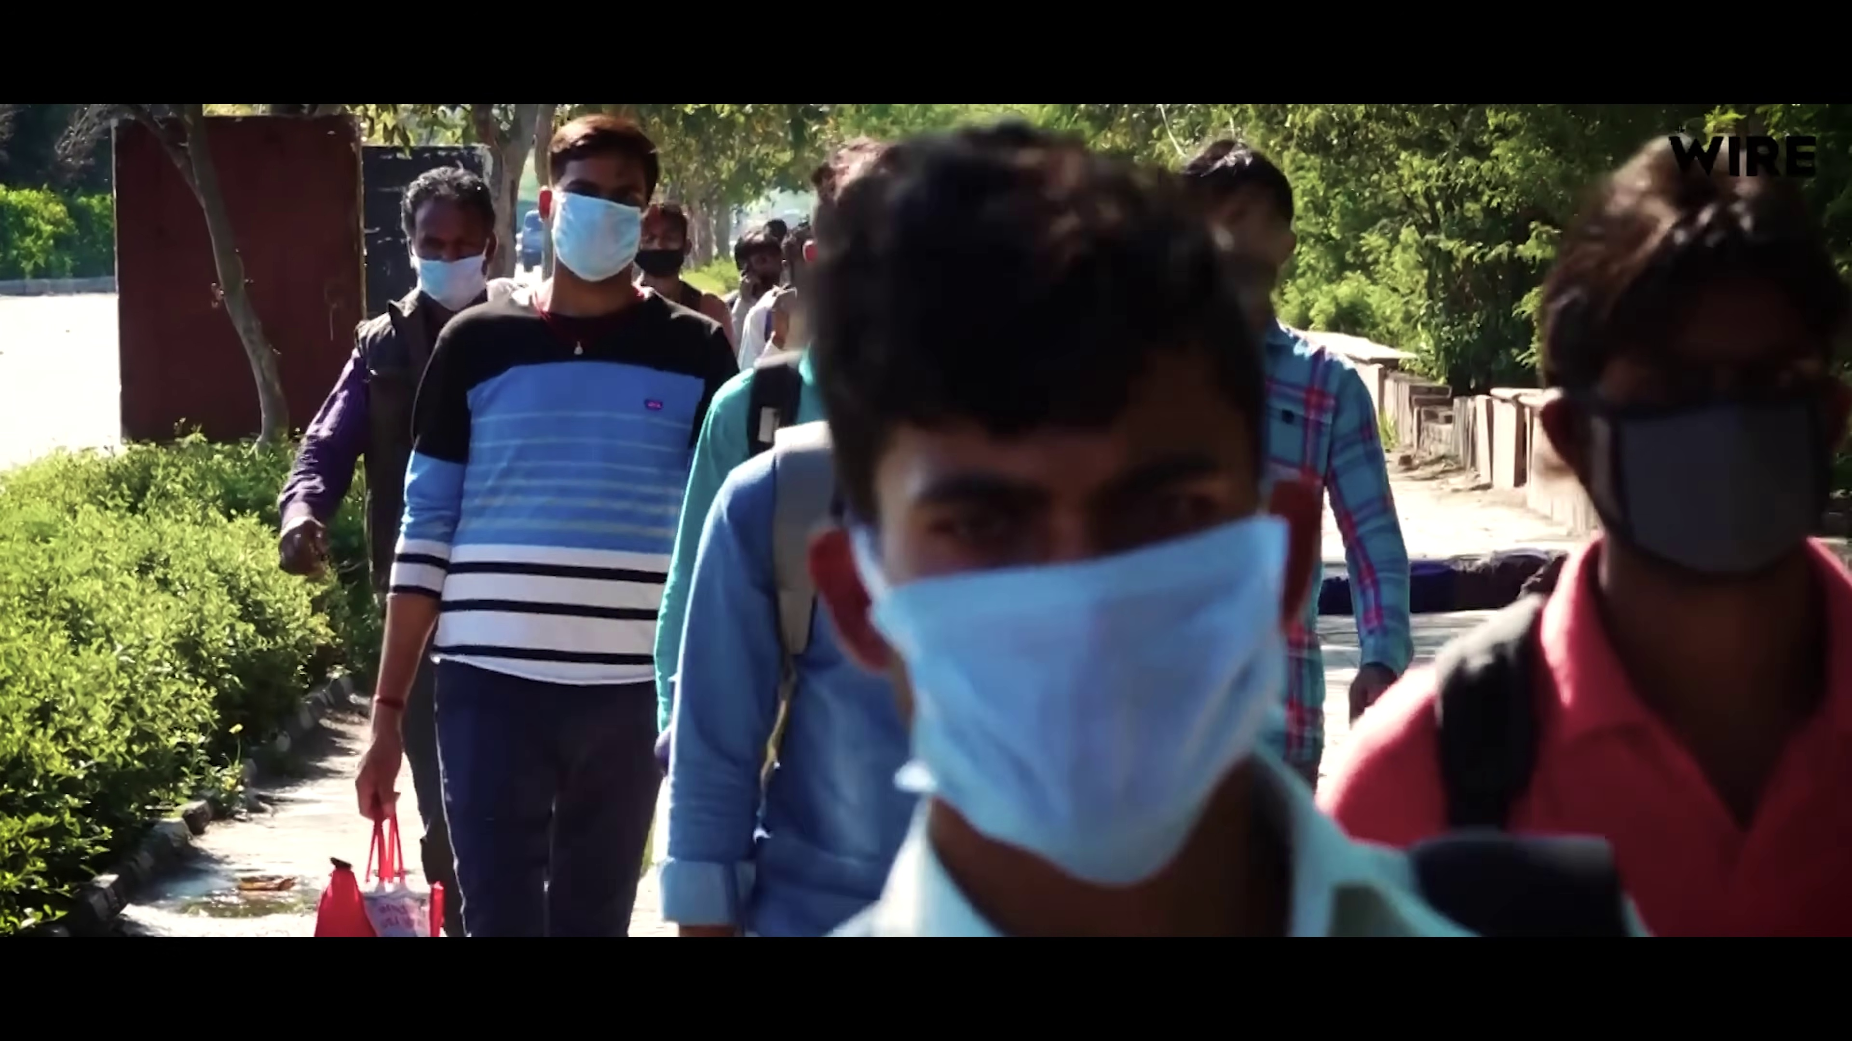
संघर्ष के 1280 दिन
1280 Days of Struggle: The Documentary Journey
Prashant Kishor | Jan Suraaj | Bihar

Slide 2
The Core Philosophy
Why the struggle began
Covid-19 & The Plight of Migrants
• The lockdown exposed the deep crisis of migration (Palayan) in Bihar.
• Workers stranded in Gujarat, Maharashtra, and across India.
• Poverty (Garibi), Unemployment (Rojgar), and Hunger (Bhukhmari) highlighted the failure of previous governments.

Slide 3
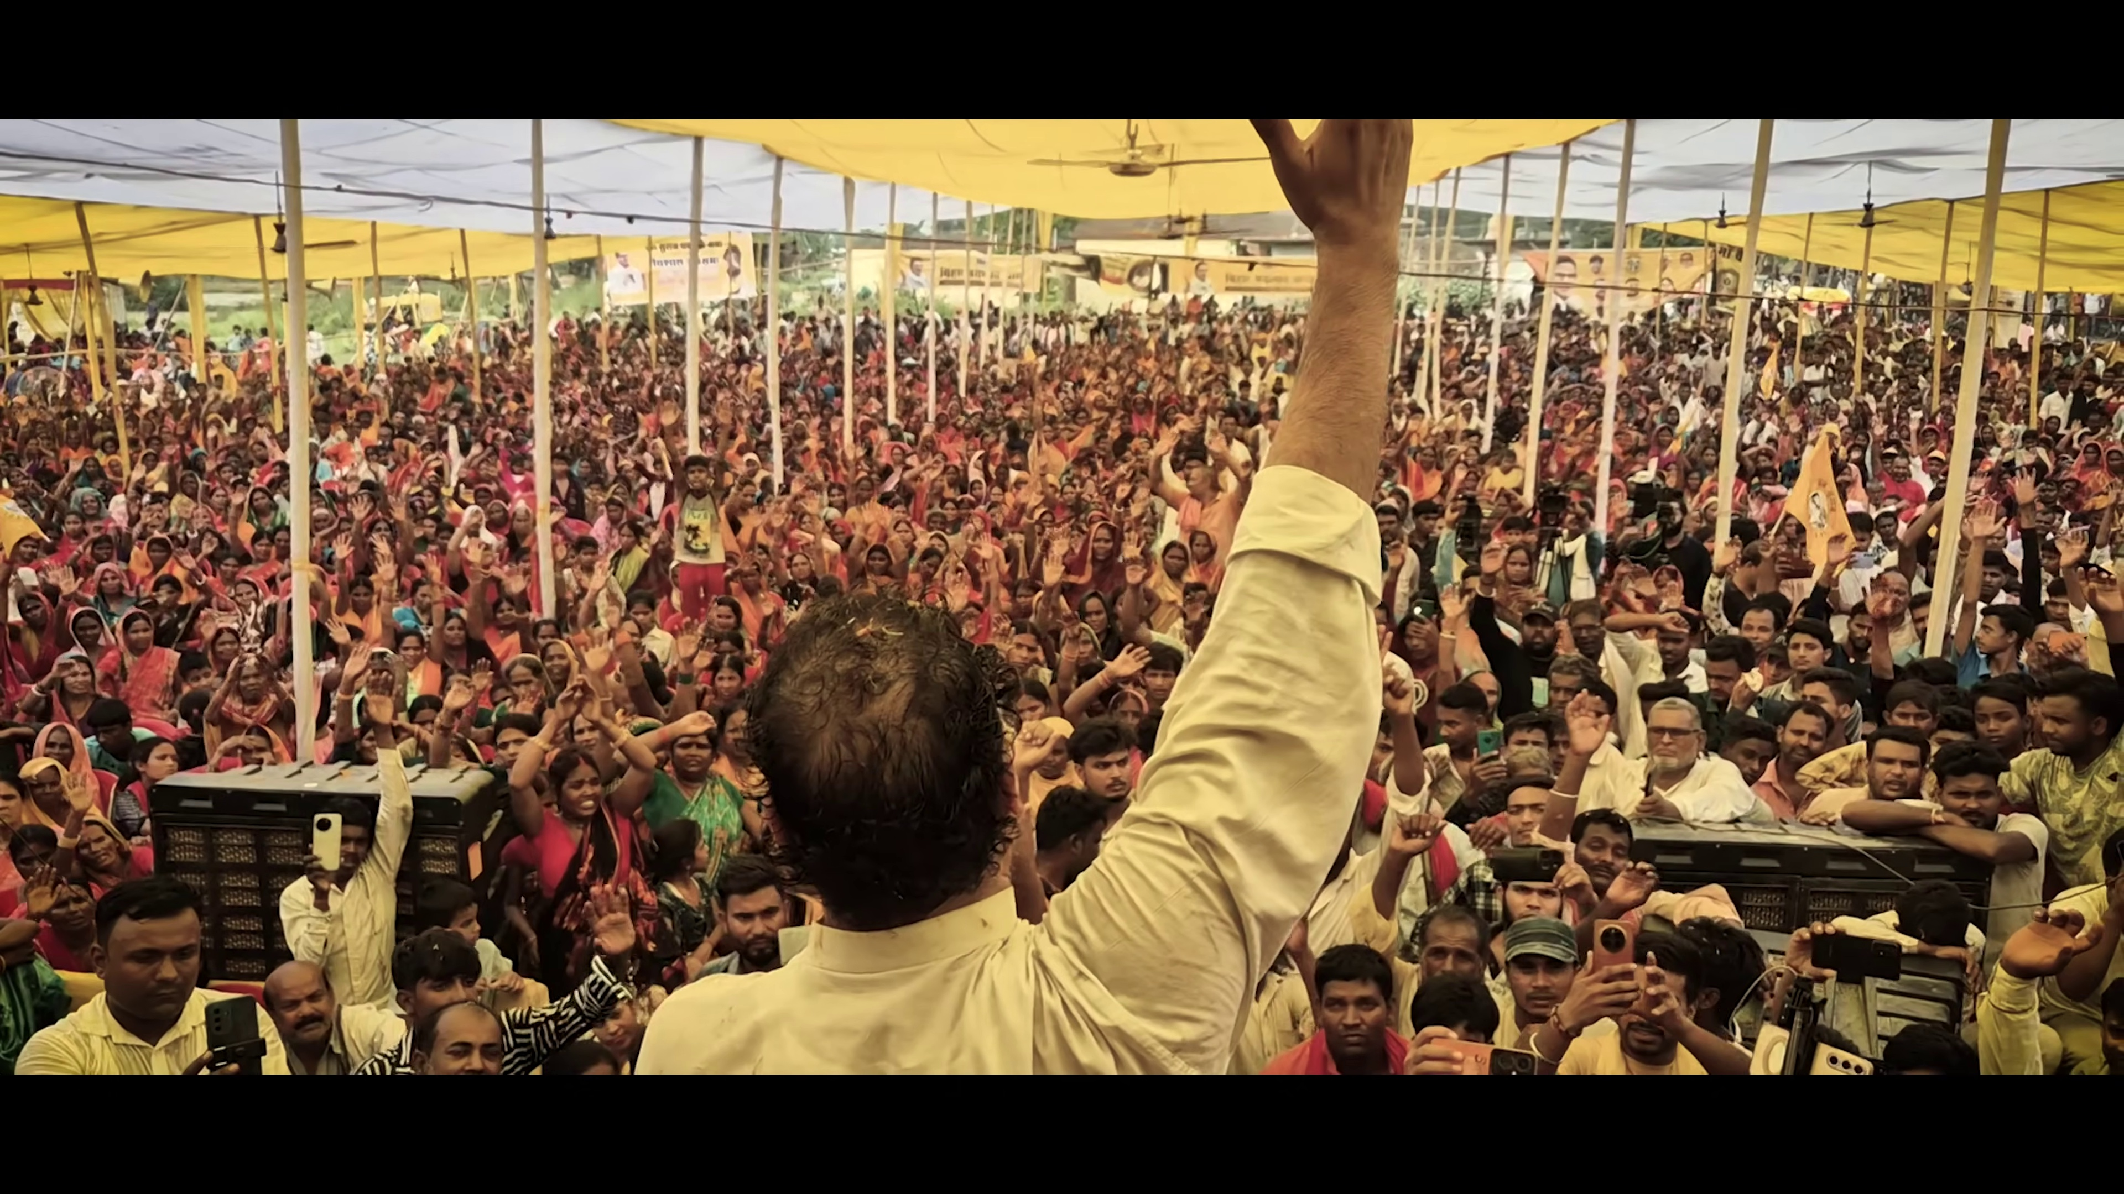
Roots of the Movement
Drawing inspiration from history
Historical Turning Points
• Bhitiharwa Gandhi Ashram: The starting point of the padyatra in West Champaran, mirroring Gandhi's Satyagraha.
• Baba Saheb Ambedkar: Upholding constitutional values and social justice.
• Sitab Diara: Inspired by Jayaprakash Narayan (JP) and the Total Revolution movement.
• A true 'Bihar Badlav Yatra'.

Slide 4
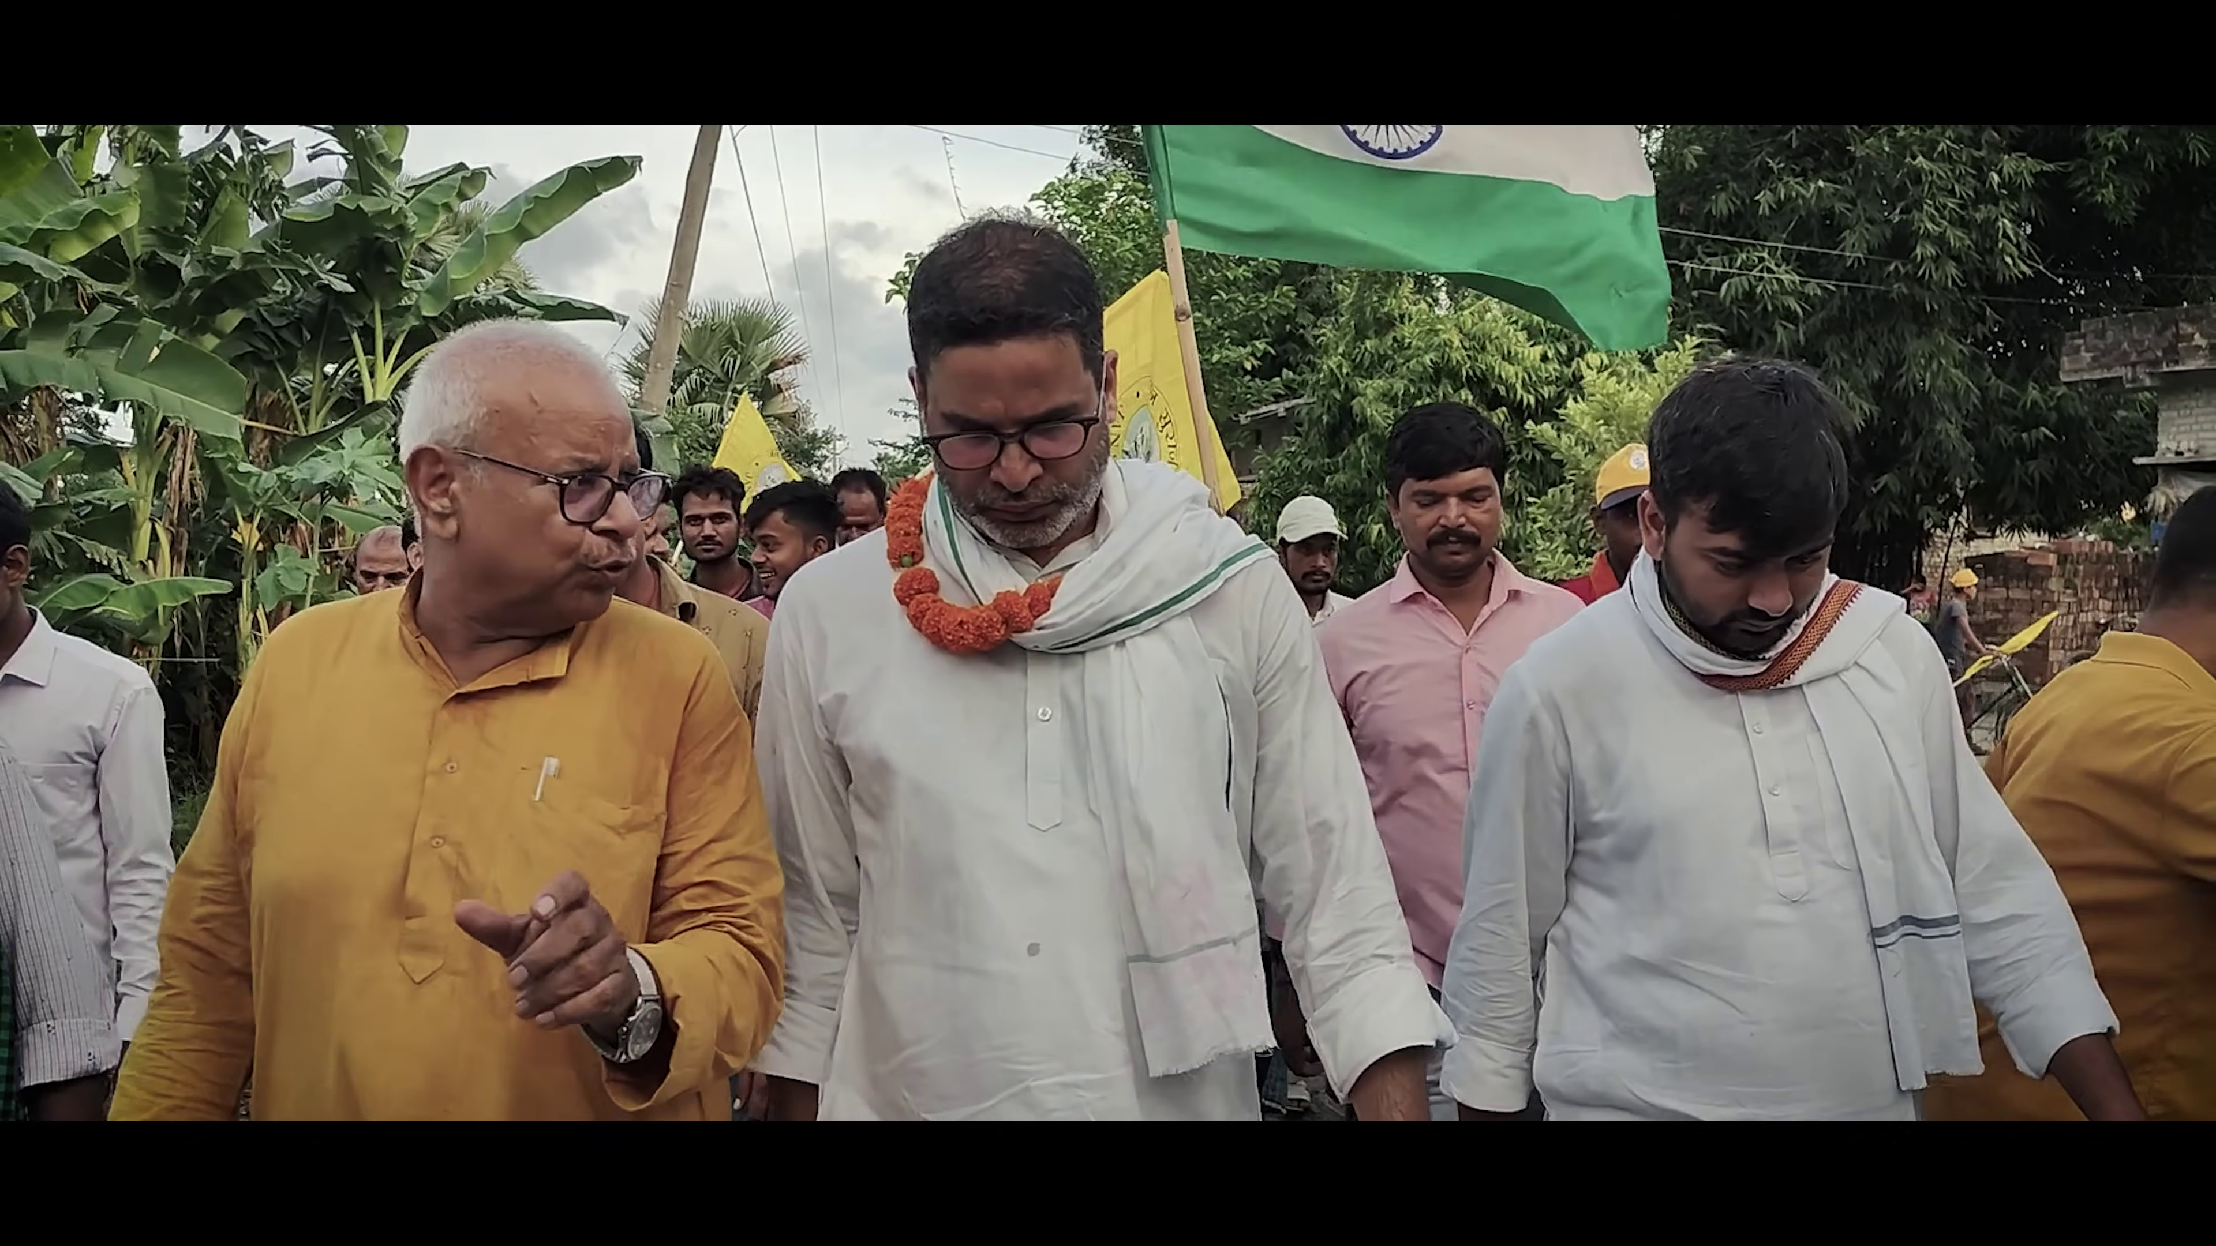
The 1280 Days of Padyatra
Unprecedented grassroots connection
A March Across Bihar
• Objective: Walking through every village, connecting directly with people, bypassing traditional political rallies.
• The padyatra covered thousands of kilometers, deeply analyzing local issues at the Panchayat level.
• Engaging with youth, women, and farmers to understand their realities first-hand.

Slide 5
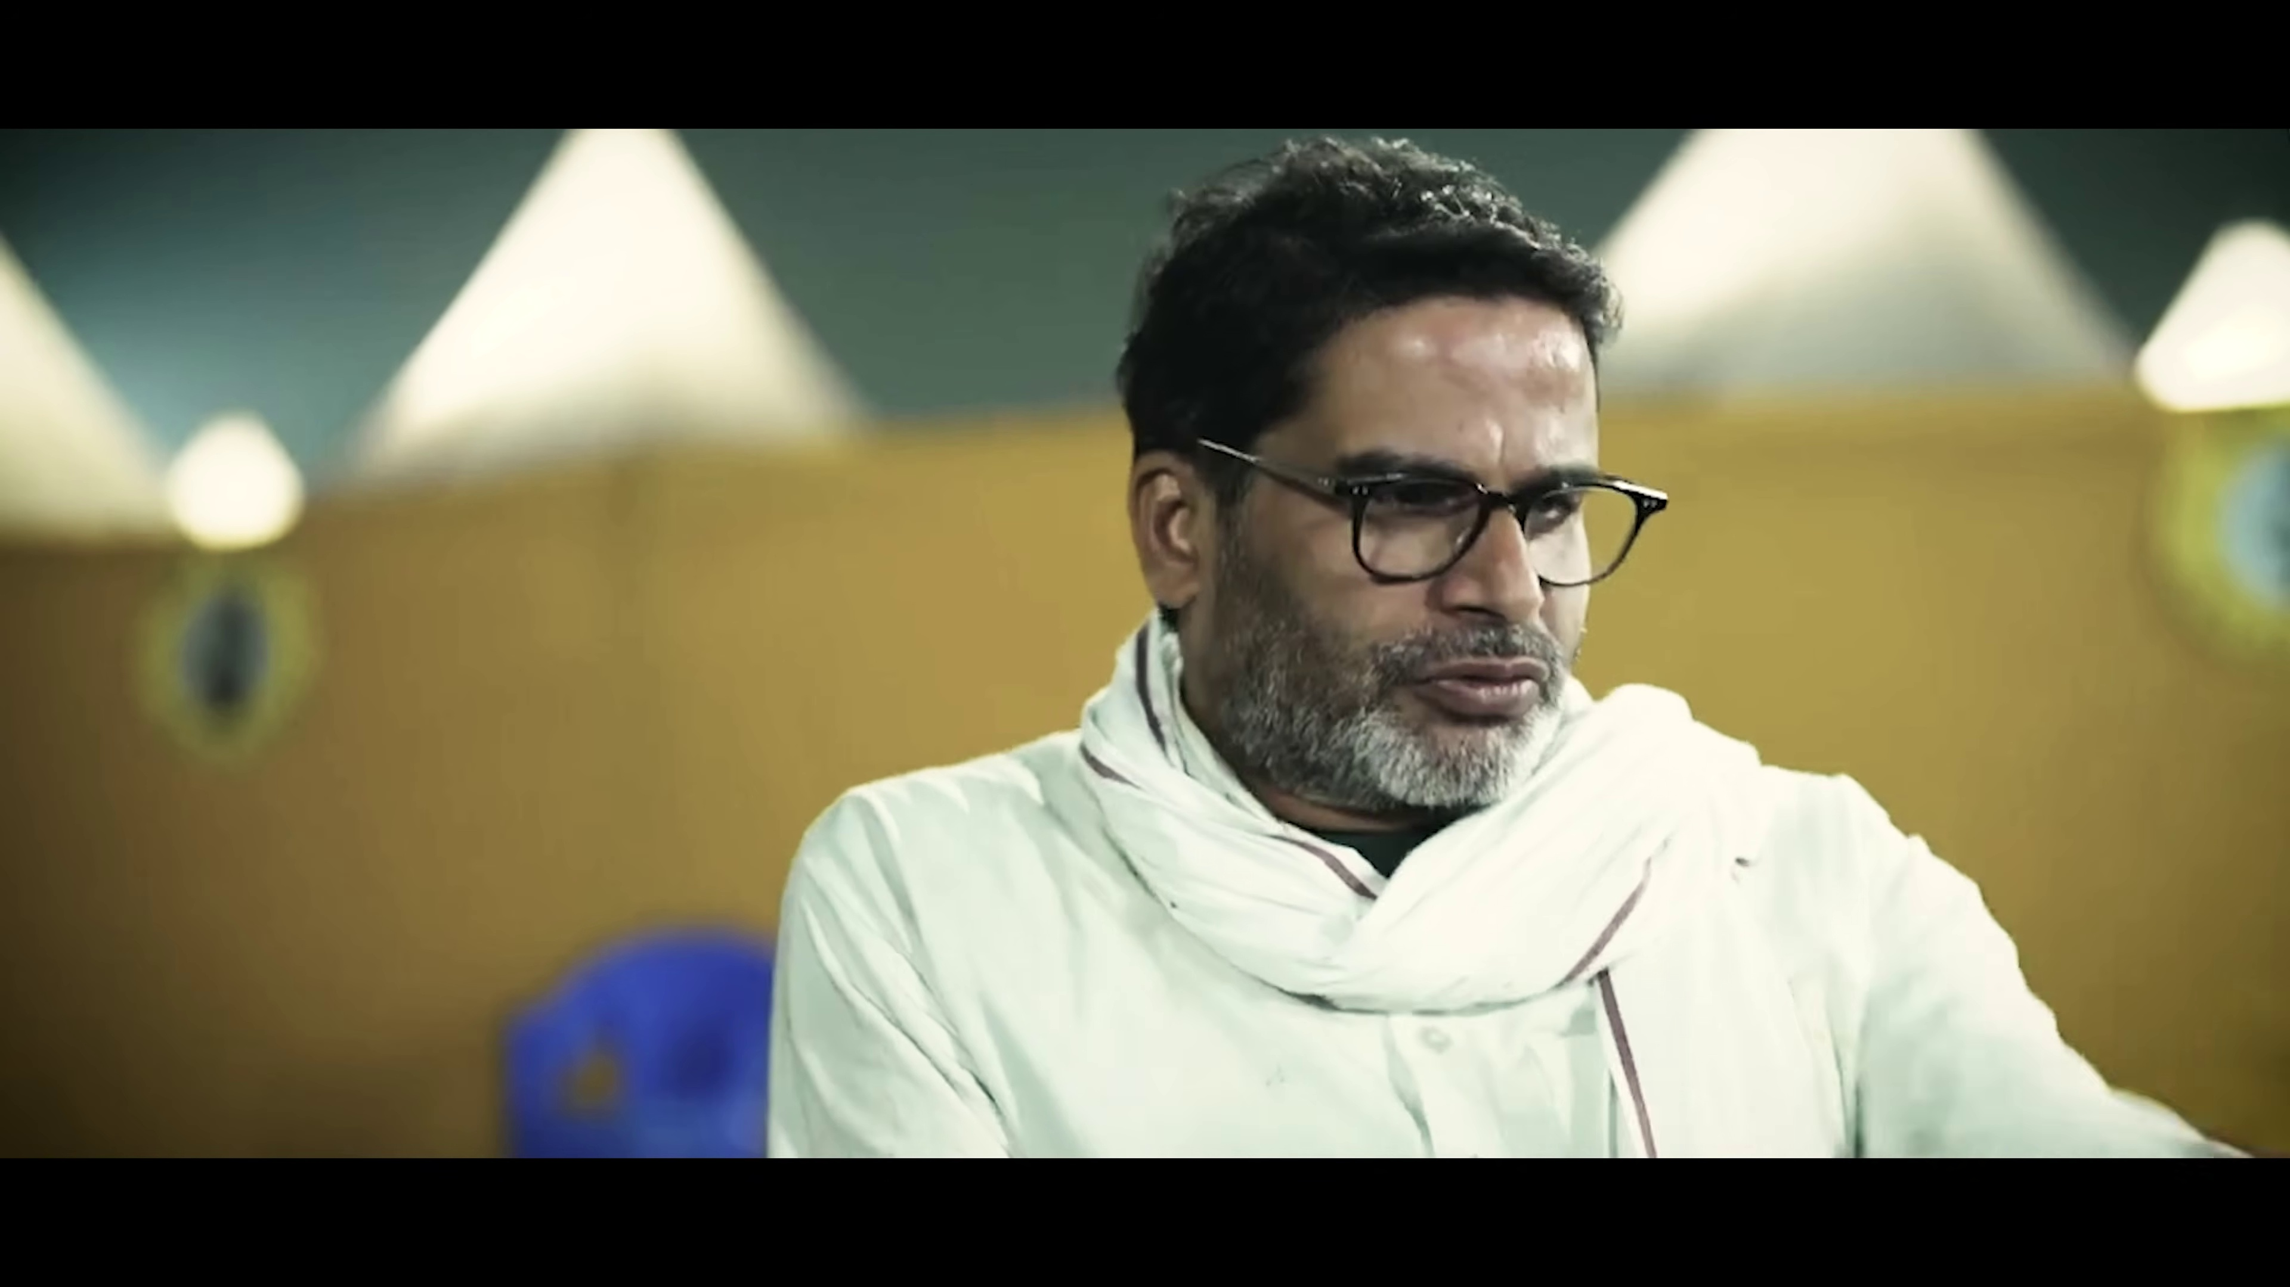
October 2: Party Launch
From a movement to a political alternative
The Jan Suraaj Party is formally launched as a democratic alternative, emphasizing transparency and collective leadership over family dynasties. 2 November became a focal point for the Bihar Badlav Rally.

Slide 6
Symbol of Change: School Ka Basta
Education as the ultimate tool for liberation
• The party symbol 'School Bag' represents the focus on Education (Shiksha).
• The core belief that investing in children's education is the only way out of generational poverty.
• Moving away from caste-based voting towards voting for the future of the children.

Slide 7
Protests & Elections
The ongoing fight for justice
Student Protests & Elections
• Taking a stand for youth: The BPSC hunger strike highlighting systemic issues in employment.
• Engaging in electoral politics: Testing the waters in by-elections and preparing for state assembly elections.
• Continuous mobilization and restructuring of the organization.

Slide 8
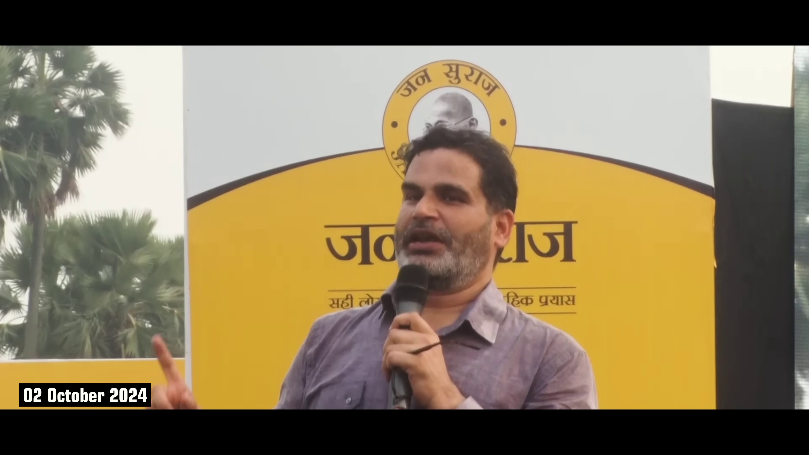
The Vision Forward
Bihar Badlav Yatra
A New Bihar is Possible
After 1280 days of intense struggle, Jan Suraaj has established a formidable presence at the grassroots level. The journey continues with a steadfast focus on stopping migration, generating employment, and empowering the people of Bihar.

